Slide 1
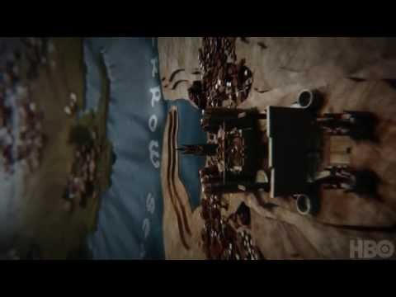
ANALYSING
GAME OF THRONES

Slide 2
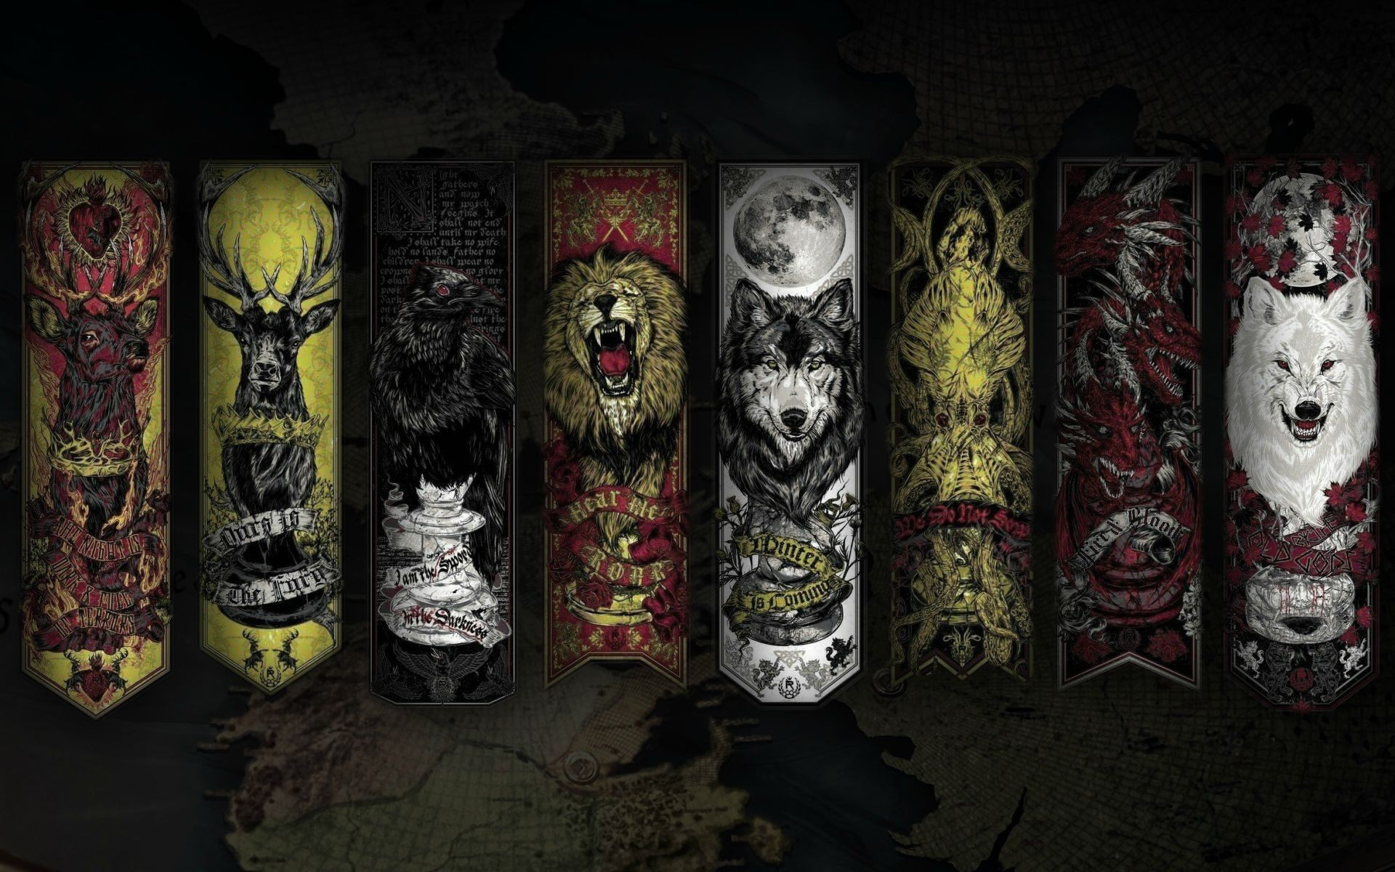
WHY GAME OF THRONES?
WIth the new season coming soon this Summer, everyone is very excited about it!
Analysing Game of Thrones is a good way to understand the dynamics of this immensely popular TV show based on the book by George RR Martin.
The show is based on a fictional time when the world is divided into Seven Kingdoms of Westeros and the continent of Essos.
With the help of Visual Analytic tools we have tried to gain insights on the various battles, kingdoms and kings.

Slide 3
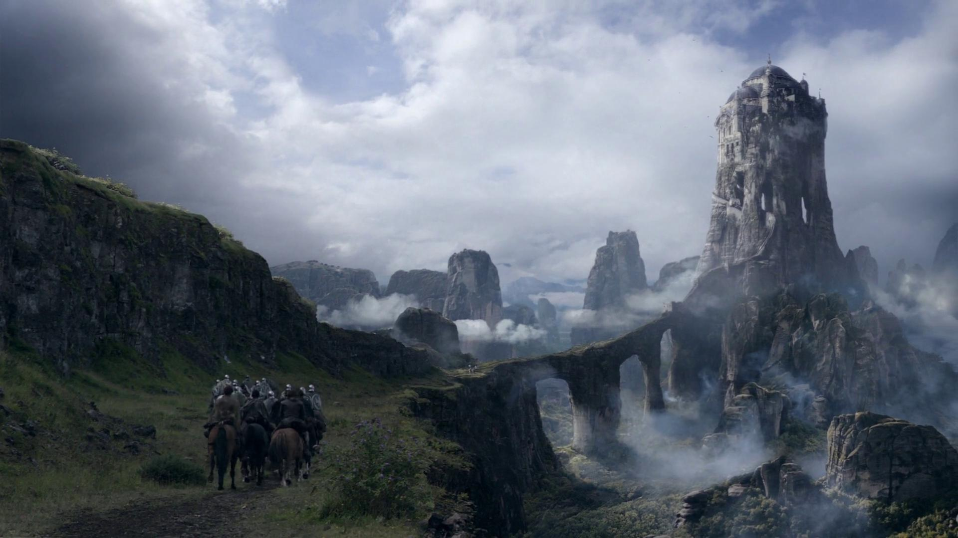
About the Dataset
The dataset contains details on all the battles fought, details on who won and loss, characters who died in the battle's, location of the battles and whether the characters are alive or not.
All these details have been aggregated in 3 csv files that have been joined to perform visual analytics.

Slide 4

1.
PRELIMINARY ANALYSIS
Initial analysis done using Excel and TIBCO Spotfire

Slide 5

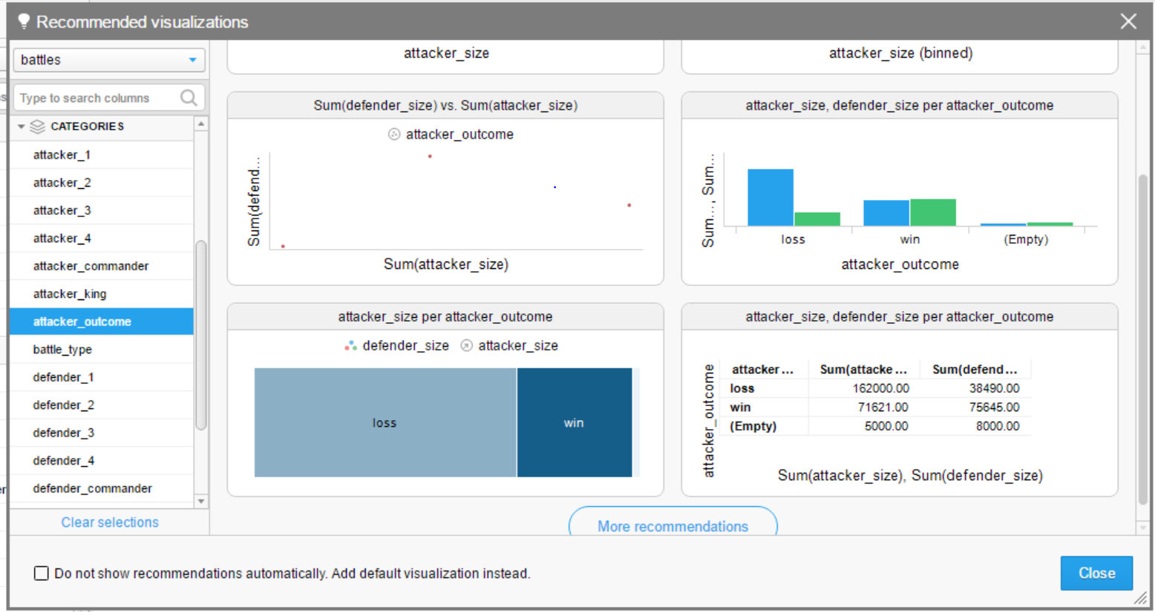
TIBCO Spotfire

Slide 6
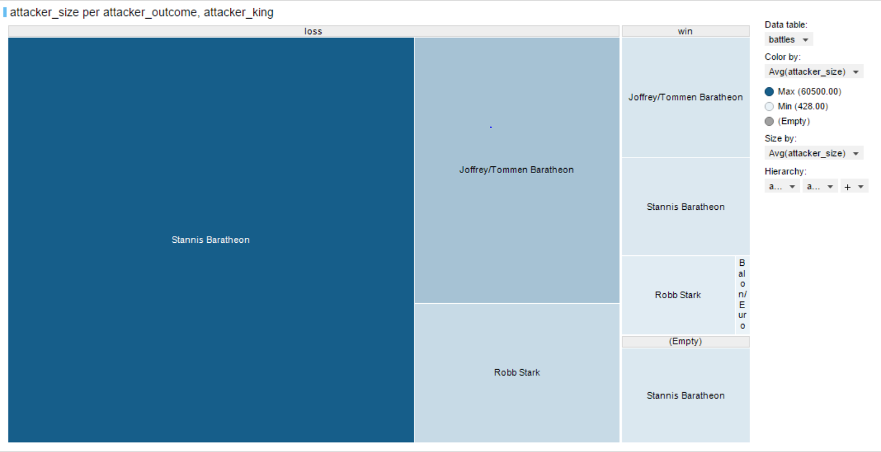
Stannis Baratheon, despite of having the largest attacking army, has the maximum losses!
Notes:
Surprising fact

Slide 7
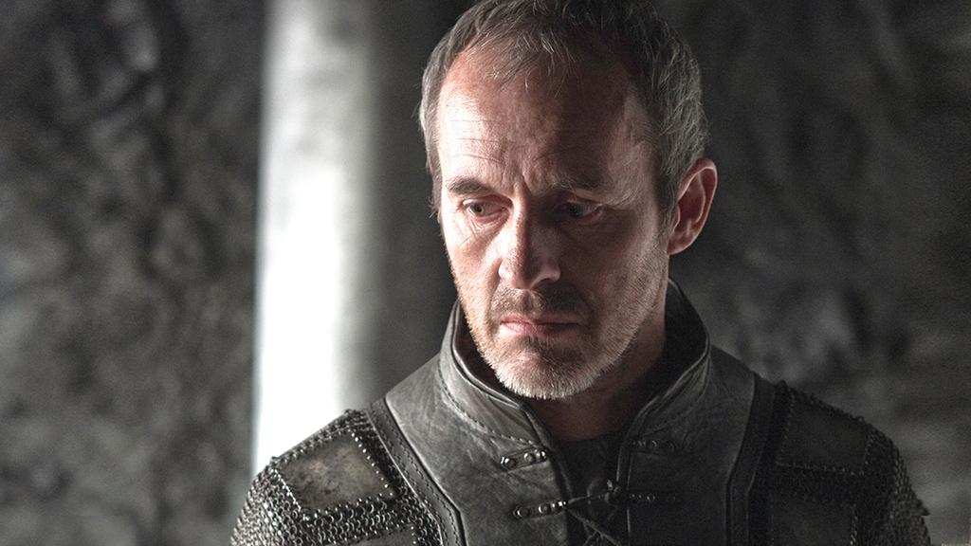
Stannis Baratheon, despite of having the largest attacking army, has the maximum losses!
Notes:
Surprising fact

Slide 8
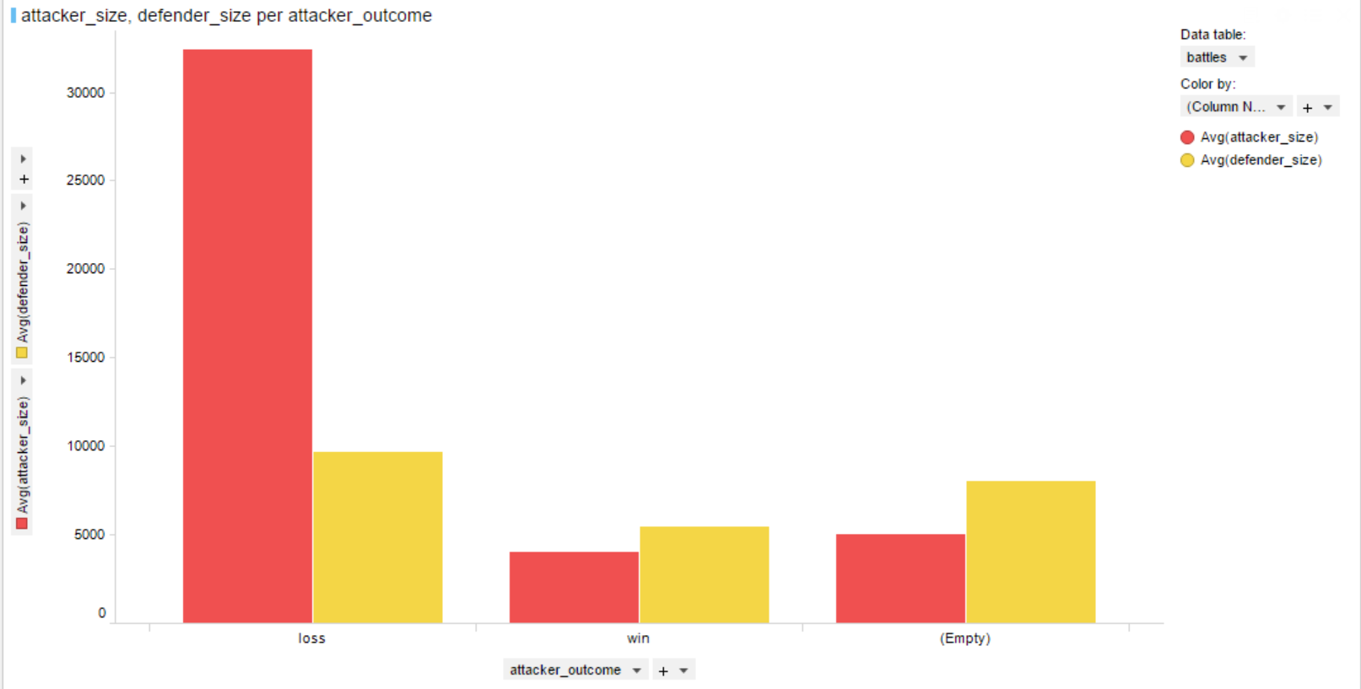
When the attacking army size is large, the chances of them losing is very high!
Notes:
Surprising fact

Slide 9
2.
DATA CLEANING
Data Cleaning and Preparation done using Excel and Tableau

Slide 10
DATA CLEANING AND PREPARATION
Made all Alias’ using Excel
Understood Basic relations using Spotfire
Imported Datasets in Tableau

Slide 11
3.
MAIN INSIGHTS
Final analysis done using Tableau, R and WordCloud
Notes:
Methods and evidence

Slide 12
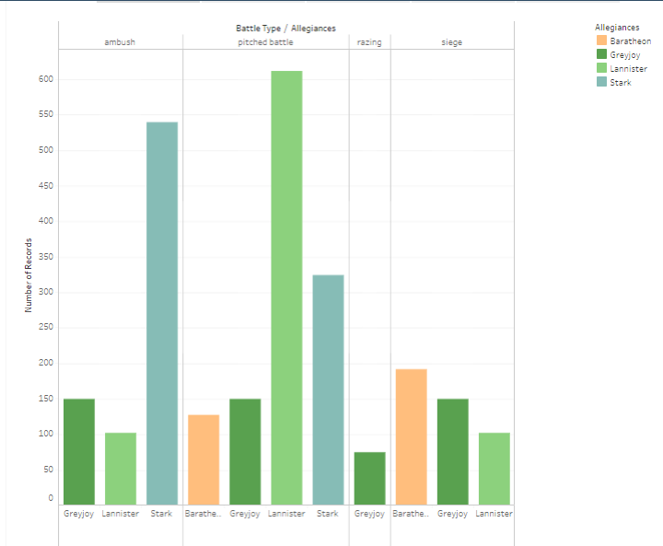
Visualizations using Tableau
How many battles are fought by each house according to battle type?
Lannisters have been highly involved in pitched battles and Starks in ambush!!

Slide 13
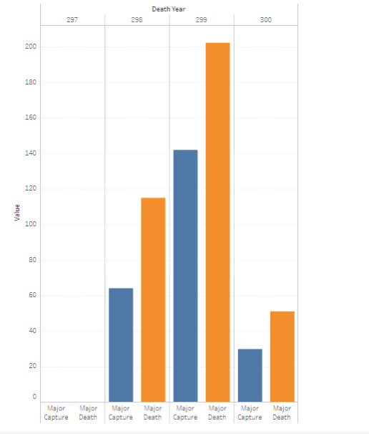
Visualizations using Tableau
Which year had the most major deaths and most major captures?
The year 299 had the most of them!!

Slide 14
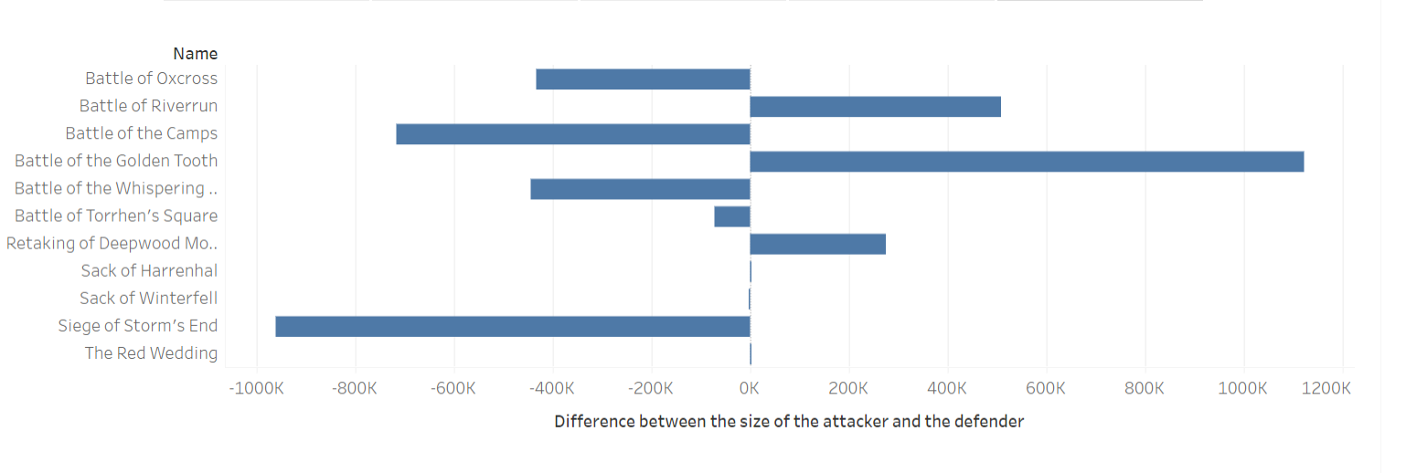
Visualizations using Tableau
Difference between the attacker army and the defending army when the attacking side WON.
We see that despite the defending army size being much larger in the Siege of Storm’s End, the attacking side wins!

Slide 15
Visualizations using Tableau
Analysis of GoT Story:
Here is the Story!

Slide 16
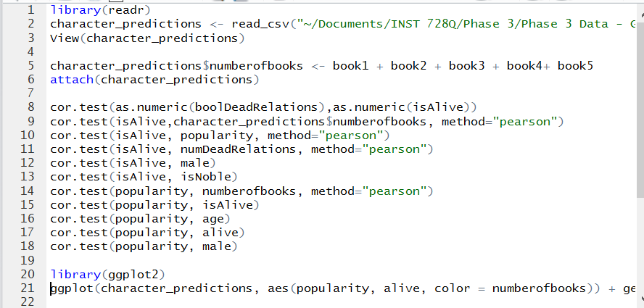
Data Analytics using R

Slide 17
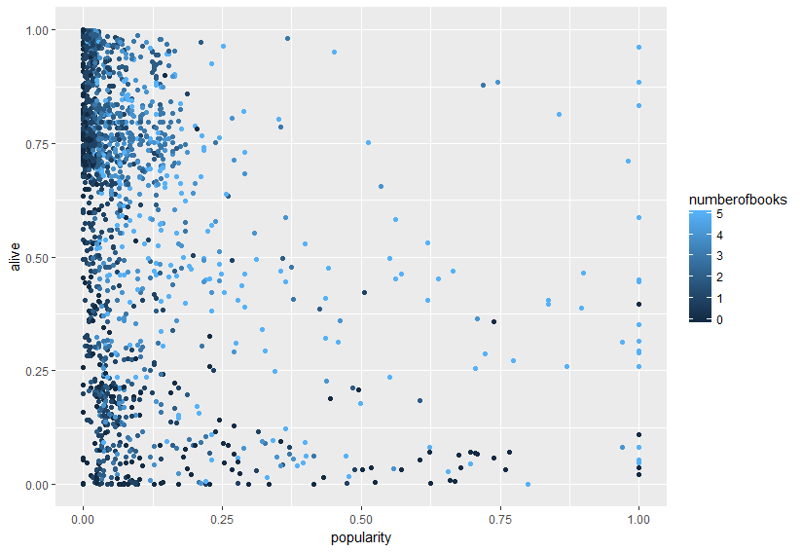
Negative Correlation between ‘Predicted - Alive’ and ‘Popularity’

Slide 18
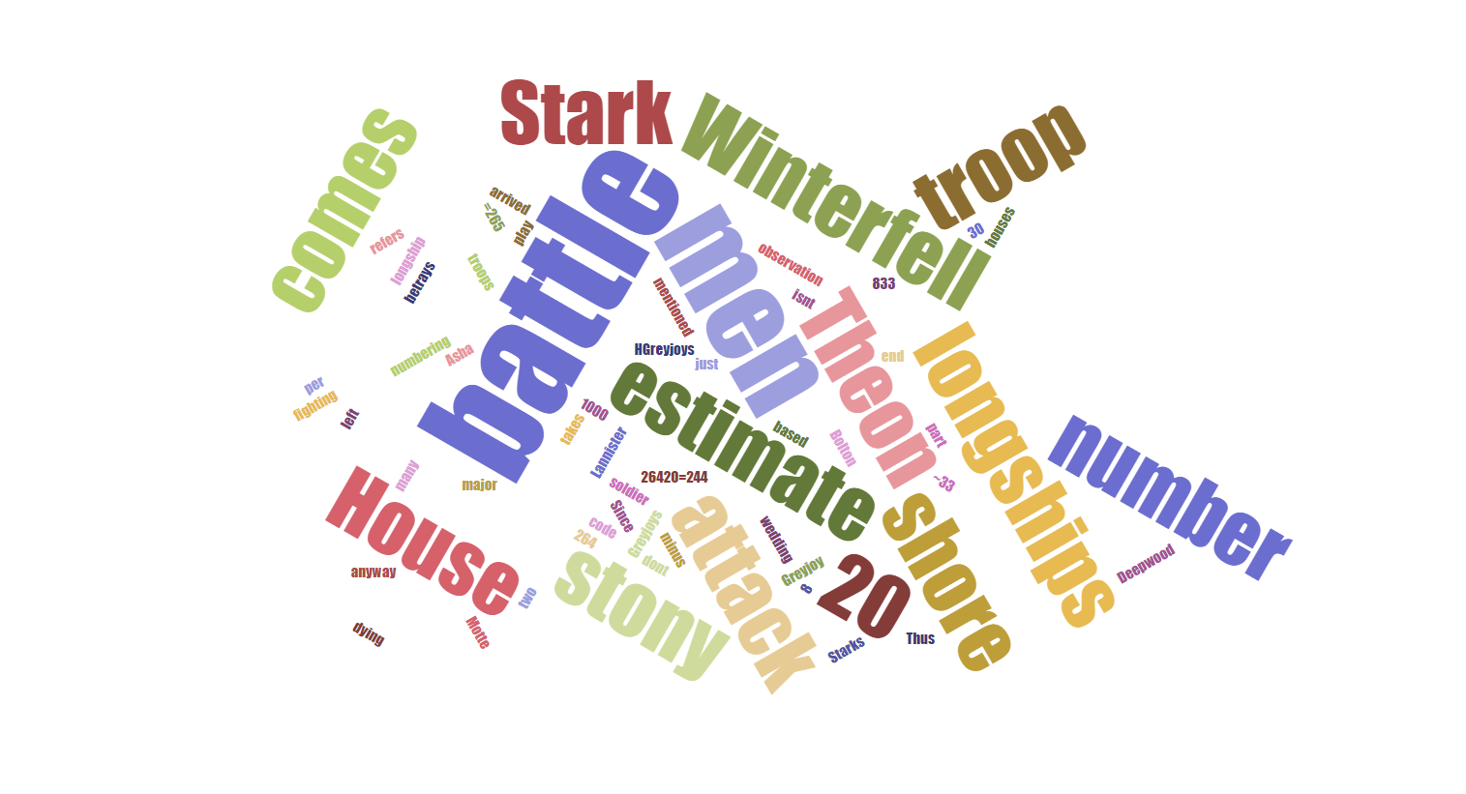
Text Analysis using WordCloud
Notes:
Explain about notes column in dataset

Slide 19
Word Cloud created using ‘Notes’ column
Created a Word Cloud to understand the popular terms for the notes made for all the Battles.
We noticed that there were maximum notes on for Starks, Winterfell and Theon!

Slide 20

THANK YOU
Presented by -
Agent Poirot (Paridhi Mathur)
Agent Diamond (Ruchira Kapoor)

Slide 21
Winter is Coming!

